Slide 1


Slide 2

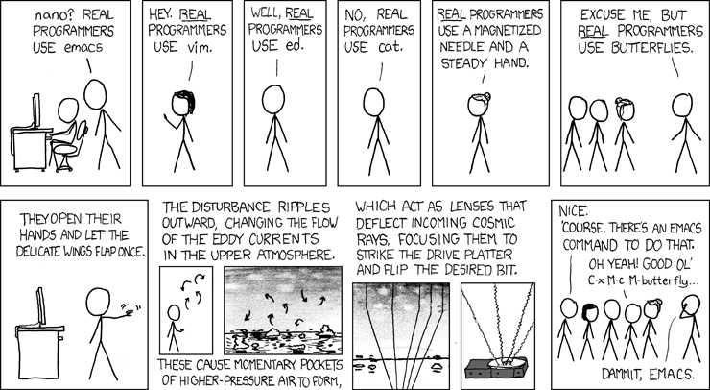
Unix Editors
Winter 2022
CS2211b - 2022

Slide 3
Unix editors
Come in two types
Modal
An “input” mode and a “control” mode
E.g. vi and ed
Modeless
E.g. pico and emacs
Unix Editors

Slide 4
ed
ed – Line editor
The original text editor
Generally superseded by vi
https://en.wikipedia.org/wiki/Ed_(text_editor)
Unix Editors

Slide 5
vi
Much more popular
Found on nearly any Unix system
Has three modes
Input
Command
Colon command
Unix Editors

Slide 6
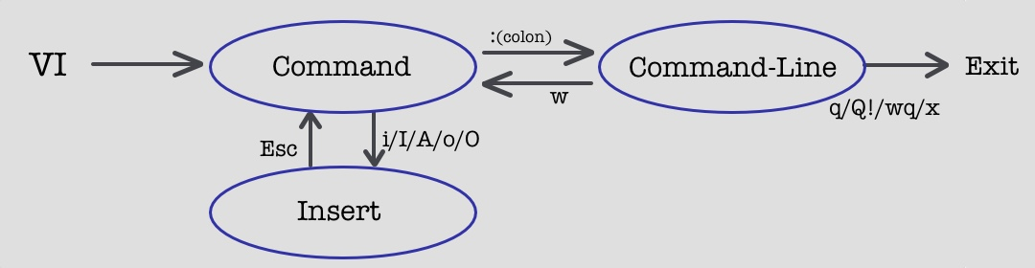
vi
Unix Editors

Slide 7
vi
vi <filename>
If the file already exists, you will see the file contents
If the file does not exist, you will have a blank file ready for input
The bottom of the screen will show the filename and the line/column number of the cursor
Unix Editors

Slide 8
vi
Common commands
Arrow keys – navigate around
i or a – change to “insert” or “append” mode
ESC – change to “command” mode
x – delete the current character
3x deletes 3 characters
Unix Editors

Slide 9
vi
Common commands
dd – delete the entire line
3dd deletes 3 lines
u – undo
/string – search for “string”
Unix Editors

Slide 10
vi
Common commands
:w – write the file
:wq or :x – write the file and quit
:q – quit
:q! – quit discarding any changes
Unix Editors

Slide 11
vi
Common commands
:%s/foo/bar/g – search for any instance of regular express “foo” and replace it with the string “bar”
More on regular expressions later
Unix Editors

Slide 12
emacs
Modeless but uses “Meta” (usually ALT or ESC) and CTRL to perform functions
Has a graphical option if you are at a GUI terminal
Key combinations
E.g. C-x – CTRL + x
E.g. C-x s – CTRL + x + s
Unix Editors

Slide 13
emacs
Common key combinations
C-x C-s – Save file
C-x C-c – Quit
C-_ or C-x u – Undo
C-a and C-e – Goto start or end of line
C-g – abort a partial command
Unix Editors

Slide 14
emacs
Popular because you can define your own key combination to do whatever you want (think Macros in Microsoft Office)
https://i.imgur.com/SKm6x.png
Unix Editors

Slide 15
Pico and nano
Simple text editors that are always in insert mode
Control options are always displayed at the bottom of the screen
Unix Editors

Slide 16
What editor should you use for this course?
Probably none of these.
Use a graphical editor on your desktop and upload your code
VSCode (https://code.visualstudio.com/)
Notepad++ (https://notepad-plus-plus.org)
CLion (https://www.jetbrains.com/clion/)
Unix Editors

Slide 17
Youtube links
Fireship
Vim in 100 seconds (https://youtu.be/-txKSRn0qeA)
Vim vs Emacs. Which is better (https://youtu.be/VaBdlcYaZLQ)
Unix Editors

